Slide 1



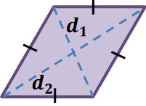
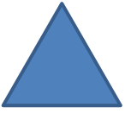
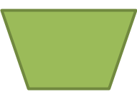







Area and Volume 1
Area of different shape
2
l
Area of square
$$=$$
l
h
Area of parallelogram
$$=$$
bh
l
b
w
Area of rectangle
$$=$$
lw
d
d
Area of rhombus
$$=$$
1
2
2
l
b
1
bh
b
$$+$$
b
Area of triangle
1
2
h
$$=$$
h
Area of trapezium
$$=$$
2
2
b
b
2

Slide 2

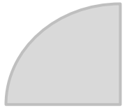
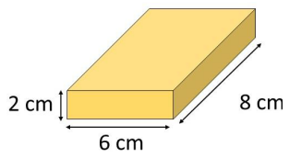
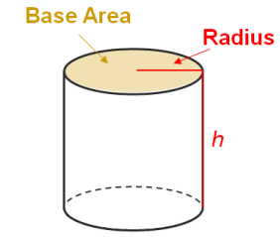











r
2
2
$$θ$$
$$=$$
$$π$$
r
$$=$$
$$π$$
Area of circle
Area of Sector
r
$$×$$
360
$$θ$$
r
Volume of Prism
Volume of Prism
$$=$$
base area
$$×$$
h
$$=$$
$$π$$
2
Volume of cylinder
r
h

Slide 3
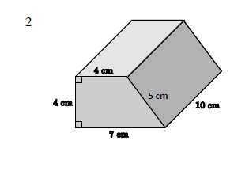






























$$=$$
2
2
2
$$×$$
22
cm
$$×$$
base area
$$=$$
44
2
cm
Total area of all lateral faces
$$=$$
$$×$$
10
2
($\text{7}$
4
cm
$$+$$
$$+$$
4
$$+$$
5)
$$=$$
200
2
cm
1
2
(
Base area
$$=$$
4 $+\text{7}$)
$$×$$
4
cm
2
$$∴$$
Total surface area of the prism
$$=$$
22
2
cm
$$=$$
($\text{44}$
$$+$$
200)
2
cm
$$=$$
244
2
Volume of Prism
$$=$$
3
cm
22
$$×$$
10
cm
$$=$$
220
3
cm

Slide 4















































(a)
Let r mm be the base radius of the cylinder
Let h mm be the height of the cylinder
$$∵$$
Circumference of its base
$$=$$
$$∵$$
Total surface area
2
32$π$
mm
$$=$$
1312$π$
mm
25
$$∴$$
2$π\text{r}$
$$=$$
32$π$
$$∴$$
2$π$
$$×$$
$$+$$
$$×$$
2
$$=$$
$$×$$
16
h
2$π$
16
1312$π$
32$π$
16
32$π\text{h}$
512$π$
$$=$$
1312$π$
$$\text{r}$$
$$=$$
$$+$$
2$π$
32$π\text{h}$
$$=$$
800$π$
$$=$$
16
h
$$=$$
25
$$∴$$
The base radius of the cylinder is 16 mm
$$∴$$
The height of the cylinder is 25 mm
(b)
Volume of the cylinder
$$=$$
$$π$$
2
$$×$$
3
$$×$$
16
25
mm
$$=$$
6400$π$
3
mm

Slide 5
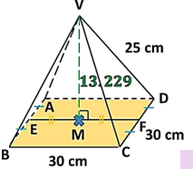

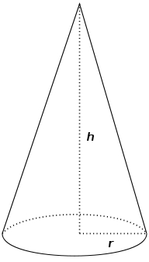






Volume of Pyramid
1
Volume of Pyramid
$$=$$
$$×$$
base area
$$×$$
h
3
1
2
Volume of Cone
$$=$$
$$×$$
$$π$$
r
h
3

Slide 6
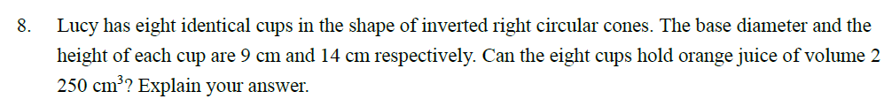













Total capacity of the eight cups
9 cm
1
9
2
$$=$$
$$×$$
$$π$$
$$\text{1}\text{4}$$
3
8
$$×$$
$$×$$
$$×$$
cm
3
2
14 cm
$$=$$
2375
cm
3
3
(cor. to the nearest )
cm
$$>$$
2250
cm
3
$$∴$$
The eight cups can hold orange juice of volume
2250
cm
3

Slide 7
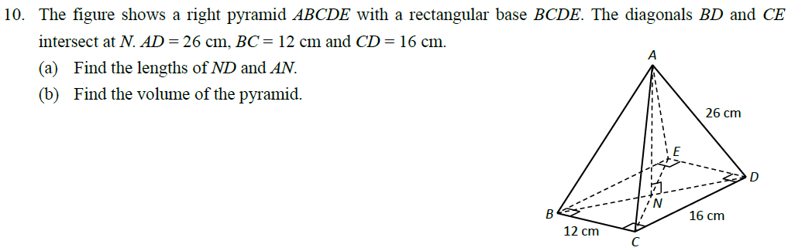



































(a)
In $∆BCD,$
24 cm
BD
$$=$$
BC
2
CD
2
$$=$$
2
2
$$+$$
$$\text{12}$$
$$+$$
$$\text{16}$$
cm
$$=$$
20 cm
1
1
ND
$$=$$
$$×$$
BD
$$=$$
$$×$$
20 cm
$$=$$
10 cm
2
2
In $∆ADN,$
$$=$$
2
2
$$=$$
2
2
D
A
AN
AD
$$−$$
ND
$$\text{26}$$
$$−$$
$$\text{10}$$
cm
$$=$$
24 cm
(b)
Volume of the pyramid
10 cm
1
$$=$$
$$×$$
area of rectangle BCDE
$$×$$
AN
3
N
26 cm
1
16 cm
$$=$$
$$×$$
(16 $× \text{1}\text{2}\text{)}$
$$×$$
24
cm
3
3
$$=$$
1536
cm
3
B
C
N
D
12 cm
10 cm

Slide 8
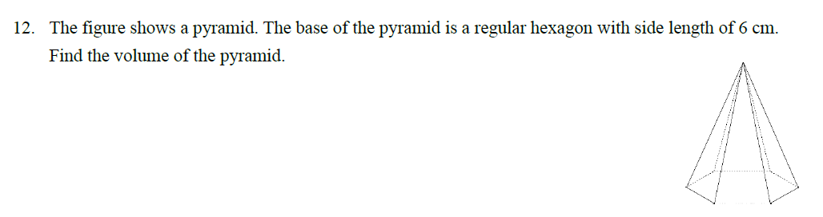


























2
$$+$$
2
2
$$\text{3}$$
$$\text{y}$$
$$=$$
$$\text{6}$$
2
$$\text{y}$$
$$=$$
27
12 cm
$$\text{y}$$
$$=$$
$$\text{27}$$
Base area
1
$$=$$
$$×$$
$$\text{6}$$
$$×$$
$$\text{27}$$
$$×$$
$$\text{6}$$
3 cm
2
6 cm
$$=$$
54
3
cm
2
y
1
6 cm
Volume
$$=$$
$$×$$
54
3
$$×$$
12
6 cm
3
216
3
3
$$=$$
cm
3
$$=$$
cm
(
374
)

Slide 9
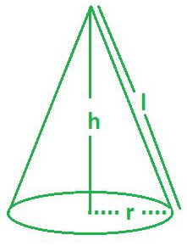
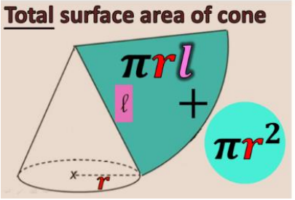








Surface area of cone
Curved surface area of cone
$$=$$
$$π$$
r
l
Total surface area of cone
$$+$$
Curved surface area of cone
$$=$$
base area
$$π$$
2
$$π$$
$$=$$
r
$$+$$
r
l

Slide 10
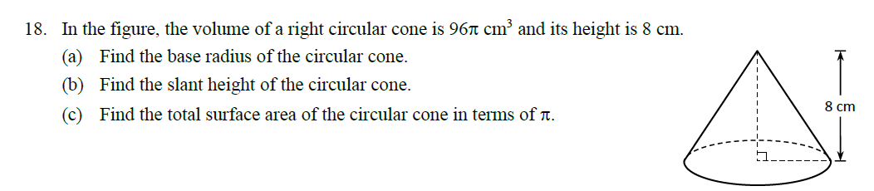






































10
(a)
Let r cm be the base radius of the circular cone
1
2
$$×$$
$$π$$
$$×$$
$$\text{r}$$
$$×$$
$$\text{8}$$
$$=$$
$$\text{96} π$$
$$\text{6}$$
3
2
$$=$$
$$\text{36}$$
$$\text{r}$$
$$\text{r}$$
$$=$$
$$\text{6}$$
$$∴$$
The base radius of the circular cone is 6 cm
(b)
Slant height of the circular cone
$$=$$
2
2
cm
$$=$$
10 cm
$$\text{6}$$
$$+$$
$$\text{8}$$
(c)
Total surface area of the circular cone
$$=$$
$$π$$
$$×$$
2
2
($π$
$$×$$
$$\text{6}$$
$$×$$
$$\text{10}$$
$$+$$
$$\text{6}$$
) cm
$$=$$
96$π$
2
cm

Slide 11
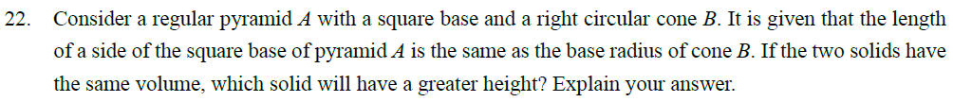





















Let r cm be the length of a side of the square base of pyramid A and the base radius of cone B
h
Let h1 cm and h2 cm be the heights of pyramid A and cone B respectively
1
h
2
$$∵$$
Volume of pyramid A $=$ volume of cone B
$$\text{r}$$
1
2
1
2
$$\text{r}$$
$$∴$$
$$×$$
$$\text{r}$$
$$×$$
h
$$=$$
$$×$$
$$π$$
$$×$$
$$\text{r}$$
$$×$$
h
3
1
3
2
h
$$=$$
$$π$$
h
1
2
i.e.
h
$$>$$
h
1
2
$$∴$$
The height of pyramid A is greater

Slide 12
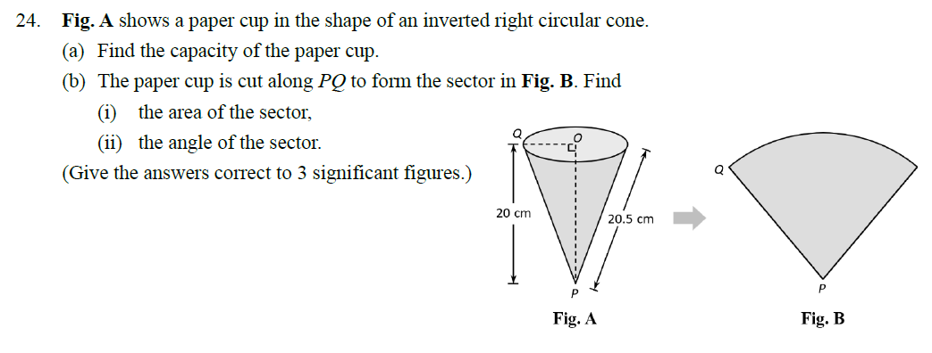
















































$$\text{4.5}$$
(a)
Let r cm be the base radius of the paper cup
$$\text{20.5}$$
$$θ$$
$$\text{r}$$
$$=$$
$$\text{20.5}$$
2
$$−$$
$$\text{20}$$
2
$$=$$
$$\text{4.5}$$
$$∴$$
Capacity of the paper cup
$$=$$
1
2
3
(bii)
Let $θ$be the angle of the sector
$$×$$
$$π$$
$$×$$
$$\text{4.5}$$
$$×$$
$$\text{20}$$
cm
3
Radius of the sector
$$=$$
Slant height of the paper cup
$$=$$
424
cm
3
(cor. to 3 sig. fig.)
$$=$$
20.5 cm
(bi)
Area of the sector
$$θ$$
2
$$×$$
$$π$$
$$×$$
$$\text{20.5}$$
$$=$$
92.25$π$
o
$$=$$
360
Curved surface area of the paper cup
o
$$π$$
$$×$$
$$×$$
2
$$θ$$
$$=$$
79.0
(cor. to 3 sig. fig.)
$$=$$
$$\text{4.5}$$
$$\text{20.5}$$
cm
$$=$$
92.25$π$
2
cm
$$∴$$
o
$$=$$
290
cm
2
(cor. to 3 sig. fig.)
The angle of the sector is
79.0

Slide 13

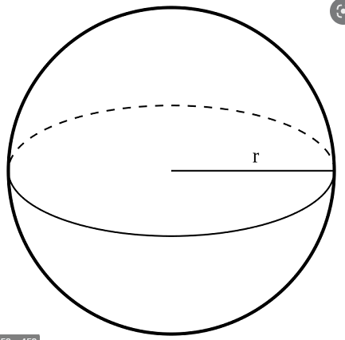




Area and Volume 2
Sphere
4
3
Volume of Sphere
$$π$$
$$=$$
$$×$$
r
3
$$=$$
$$π$$
2
Surface area of Sphere
4
r

Slide 14
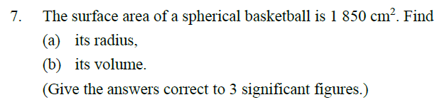


















(a)
Let r cm be the radius of the basketball
$$π$$
2
4
r
$$=$$
$$\text{1850}$$
r
2
$$=$$
925
2$π$
r
925
r
$$=$$
2$π$
$$=$$
12.1
(cor. to 3 sig. fig.)
$$∴$$
The radius of the basketball is 12.1 cm
4
925
3
(b)
Volume
$$=$$
$$×$$
$$π$$
$$×$$
3
3
cm
2$π$
$$=$$
$$\text{7480}$$
3
cm
(cor. to 3 sig. fig.)

Slide 15
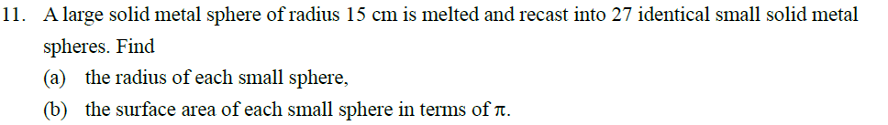

































(a)
Let r cm be the radius of each small sphere
$$∵$$
Volume of the large sphere
$$=$$
Total volume of the 27 small spheres
$$∴$$
4
3
4
3
$$×$$
$$π$$
$$×$$
$$\text{15}$$
$$=$$
$$\text{27}$$
$$×$$
$$×$$
$$π$$
$$×$$
$$\text{r}$$
3
3
3
$$\text{r}$$
$$=$$
$$\text{125}$$
$$\text{r}$$
$$=$$
$$\text{5}$$
$$∴$$
The radius of each small sphere is $\text{5 }\text{cm}$
(b)
Surface area of each small sphere
$$=$$
$$\text{4}$$
2
2
$$×$$
$$π$$
$$×$$
$$\text{5}$$
cm
$$=$$
100$π$
2
cm

Slide 16
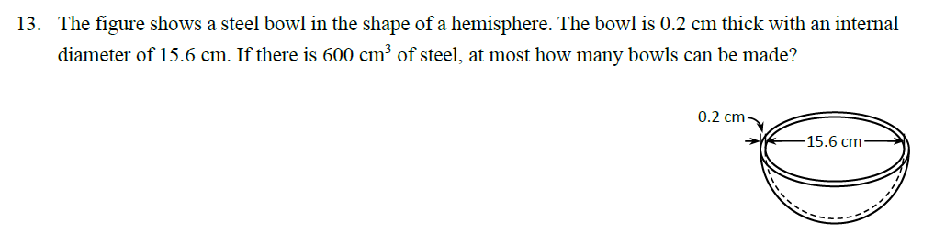






































1
Internal radius
$$=$$
$$×$$
$$=$$
15.6 cm
7.8 cm
2
External radius
$$=$$
(7.8$+$
0.2) cm
$$=$$
8 cm
Volume of steel for each bowl
1
4
3
1
4
3
$$=$$
$$×$$
$$×$$
$$π$$
$$×$$
$$\text{8}$$
$$−$$
$$×$$
$$×$$
$$π$$
$$×$$
$$\text{7.8}$$
3
cm
2
3
2
3
16 cm
$$=$$
$$\text{78.431}$$
3
(cor. to 5 sig. fig.)
$$=$$
cm
Let n be the number of bowls that can be made
n
$$×$$
$$\text{78.431}$$
$$=$$
$$\text{600}$$
$$−$$
15.6 cm
$$\text{600}$$
n
$$=$$
$$\text{78.431}$$
$$=$$
$$\text{7.65}$$
(cor. to 3 sig. fig.)
$$∴$$
At most $\text{7}$ bowls can be made

Slide 17
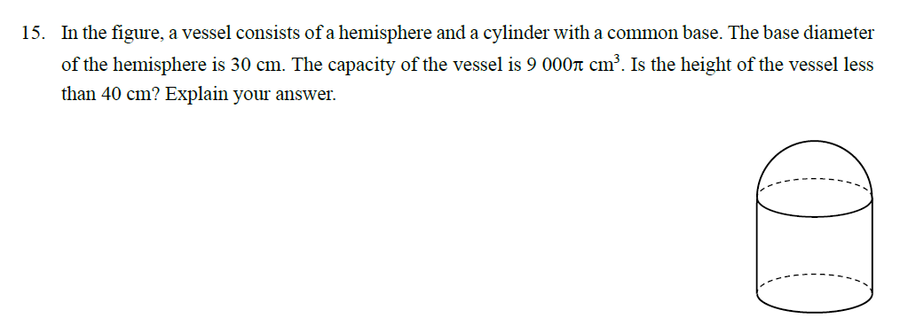






































Let h cm be the height of the cylinder
Capacity of the vessel
15
$$=$$
Volume of the hemisphere
$$+$$
Volume of the cylinder
30
1
4
30
3
30
2
3
$$=$$
$$×$$
$$×$$
$$π$$
$$×$$
$$+$$
$$π$$
$$×$$
$$×$$
h
cm
2
3
2
2
15
h
$$=$$
(2250$π+$
225$π\text{h}\text{)}$
3
$$=$$
30
cm
$$∴$$
2250$π+$
225$π\text{h}$
$$=$$
9000$π$
15
225$π\text{h}$
$$=$$
6750$π$
$$\text{h}$$
$$=$$
30
$$∴$$
The height of the vessel
$$=$$
The height of the cylinder
The radius of the hemisphere
$$+$$
$$=$$
30
30
$$+$$
cm
$$=$$
45
cm
$$>$$
40
cm
2
$$∴$$
The height of the vessel is not less than 40 cm

Slide 18
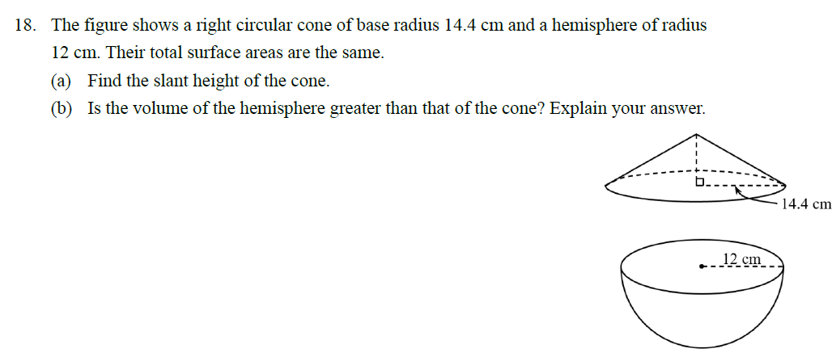








































(a)
Let l cm be the slant height of the cone
l
Total surface area of the cone
$$=$$
($π$
$$×$$
14.4
$$×$$
l
$$+$$
$π$
2
2
$$×$$
14.4 )
cm
$$=$$
14.4 $π\text{l}$
2
(
$$+$$
207.36$π$)
cm
Total surface area of the hemisphere
1
2
2
$$=$$
$$×$$
4
$$×$$
$$π$$
$$×$$
$$\text{12}$$
$$+$$
$$π$$
$$\text{12}$$
2
$$×$$
cm
2
$$=$$
432 $π$
2
cm
14.4 $π\text{l}$
$$+$$
207.36$π$
$$=$$
432 $π$
$$∴$$
The slant height of the cone is 15.6 cm
14.4 $π\text{l}$
$$=$$
224.64 $π$
$$\text{l}$$
$$=$$
15.6

Slide 19



























$=$15.6 cm
(b)
Height of the cone
$$=$$
2
2
$$=$$
$$−$$
$$\text{14.4}$$
cm
$$\text{6}$$
$$\text{15.6}$$
cm
15.6
$$\text{6}$$
1
2
3
Volume of the cone
$$=$$
$$×$$
$$π$$
$$×$$
$$×$$
$$\text{6}$$
14.4
cm
3
$$=$$
414.72$π$
cm
3
1
4
3
3
$$=$$
$$×$$
$$×$$
$$π$$
$$×$$
cm
Volume of the hemisphere
$$\text{12}$$
2
3
$$=$$
1152$π$
3
cm
$$>$$
414.72$π$
cm
3
$$∴$$
The volume of the hemisphere is greater

Slide 20
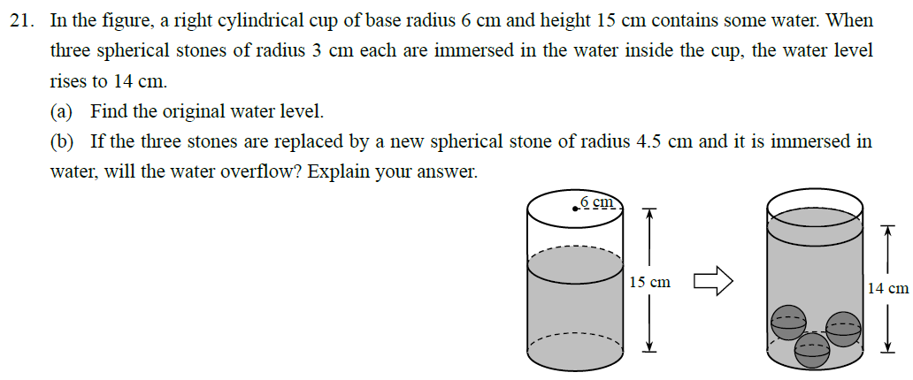






























$$\text{3}$$
(a)
Let h cm be the original water level
$$=$$
$$\text{3}$$
$$\text{3}$$
Total volume of the three stones
Volume of water that has risen
$$=$$
4
3
2
3
$$×$$
$$×$$
$$π$$
$$×$$
$$\text{3}$$
$$=$$
$$π$$
$$×$$
$$\text{6}$$
$$×$$
(14 $− \text{h}\text{)}$
14 $−$h
3
3
$$=$$
14 $− \text{h}$
h
h
$$\text{h}$$
$$=$$
$$\text{11}$$
$$∴$$
The original water level is $\text{11}$ cm

Slide 21































$$=$$
$$\text{11}$$
cm
(b)
Total volume of water and the new stone
$$=$$
$$\text{4.5}$$
$$=$$
2
4
3
3
$$π$$
$$×$$
$$\text{6}$$
$$×$$
$$\text{11}$$
$$+$$
$$×$$
$$π$$
$$×$$
$$\text{4.5}$$
cm
3
$$=$$
517.5$π$
3
cm
Capacity of the cup
$$π$$
$$×$$
2
$$\text{15}$$
3
$$=$$
$$\text{6}$$
$$×$$
cm
$$=$$
3
$$\text{11}$$
540$π$
cm
$$∵$$
517.5$π$
$$<$$
540$π$
$$∴$$
The water will not overflow

Slide 22
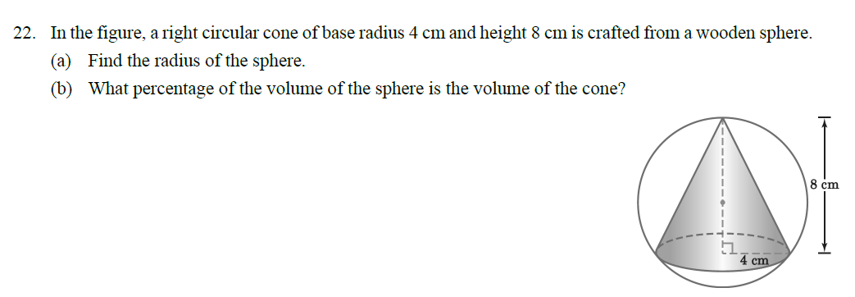































































A
(a)
Refer to the notations in the figure
r
O
Let r cm be the radius of the sphere, then
r
8 $−$r
OA
$$=$$
$$=$$
OB
$$=$$
(8 $−$r) cm
OC
r cm
and
B
C
(b)
Volume of the cone
In $∆OBC,$
1
2
3
$\text{1}$28
3
$$=$$
$$π$$
$$\text{4}$$
$$π$$
$$×$$
$$×$$
$$×$$
$$\text{8}$$
cm
$$=$$
cm
OB
2
$$+$$
BC
2
$$=$$
OC
2
(Pyth. theorem)
3
$$\text{3}$$
2
2
2
Volume of the sphere
(8 $−$r)
$$+$$
$$\text{4}$$
$$=$$
$$\text{r}$$
4
3
3
$\text{5}$00
3
$$=$$
$$π$$
2
2
$$×$$
$$π$$
$$×$$
$$\text{5}$$
cm
$$=$$
cm
$$\text{64}$$
$$−$$
$$\text{16}\text{r}$$
$$+$$
$$\text{r}$$
$$+$$
$$\text{16}$$
$$=$$
$$\text{r}$$
3
$$\text{3}$$
The required percentage
$$\text{16}\text{r}$$
$$=$$
$$\text{80}$$
$\text{1}$28
$$\text{r}$$
$$=$$
$$\text{5}$$
$$π$$
$$\text{3}$$
$$=$$
$$×$$
100%
$$=$$
25.6%
$$∴$$
The radius of the sphere is $\text{5}$ cm
$\text{5}$00
$$π$$
$$\text{3}$$

Slide 23
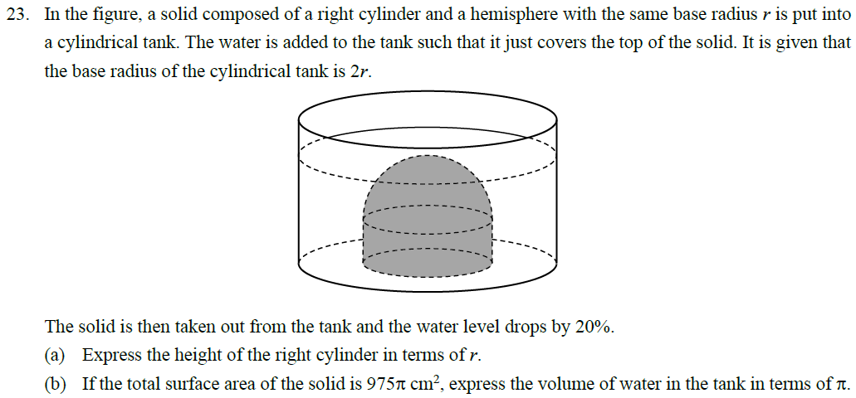









































Let h be the height of the right cylinder
1
1
(a)
Drop in water level
$$=$$
$$×$$
$$=$$
(r $+$h)
20%
r
$$+$$
h
5
5
$$∵$$
Volume of water that has dropped
r
$$=$$
Volume of the solid
r
(r $+$h)
h
$$∴$$
2
1
1
1
4
3
2
r
$$π$$
$$×$$
(2$\text{r}\text{)}$
$$×$$
r
$$+$$
h
$$=$$
$$×$$
$$π$$
$$\text{r}$$
$$+$$
$$π$$
$$\text{r}$$
h
5
5
2
3
2r
4
$$π$$
3
4
2
2
3
2
$$\text{r}$$
$$+$$
$$π$$
$$\text{r}$$
h
$$=$$
$$π$$
$$\text{r}$$
$$+$$
$$π$$
$$\text{r}$$
h
3
5
3
2
h
$$=$$
r
4
3
$$+$$
2
(r $+$h)
$$∴$$
The height of the right cylinder
$$=$$
r
5
3

Slide 24












































$$=$$
2
r
h
3
(b)
Total surface area of the solid $=$
975$π$
2
cm
1
2
2
2
$$+$$
$$\text{r}$$
$$\text{r}$$
$$+$$
$$π$$
$$×$$
4
$$π$$
2$π\text{r}\text{h}$
$$=$$
975$π$
cm
2
2
2
2
$$\text{r}$$
r
3
$$π$$
$$+$$
2$π\text{r}$
$$×$$
r
$$=$$
975$π$
cm
3
r
(r $+$h)
13
2
2
h
$$π$$
975$π$
$$\text{r}$$
$$=$$
cm
3
r
$$\text{r}$$
$$=$$
15
cm
$$∴$$
Volume of water in the tank
2r
2
4
4
2
$$=$$
$$π$$
$$×$$
(2$\text{r}\text{)}$
$$×$$
r
$$+$$
h
h
$$=$$
r
5
5
3
2
4
4
2
4
$$=$$
$$π$$
$$×$$
(2$×\text{15}\text{)}$
$$×$$
$$×$$
15
$$+$$
$$×$$
$$×$$
15
3
$$+$$
cm
(r $+$h)
5
5
3
5
$$=$$
18000$π$
3
cm

Slide 25
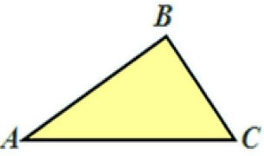
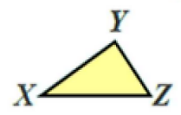











Area and Volume 3
If
$$∆ABC\sim ∆XYZ$$
$$∠A$$
$$=$$
$$∠X$$
$$=$$
$$∠Y$$
$$∠B$$
$$∠C$$
$$=$$
$$∠Z$$
And
AB
BC
CA
$$=$$
$$=$$
XY
YZ
ZX

Slide 26
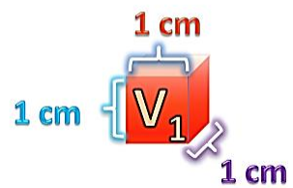
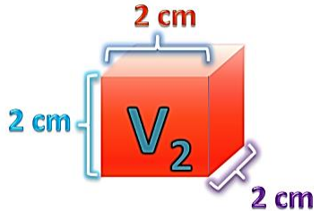




Similar Solid
L
2
A
1
Area ratio $:$
( )
$$=$$
1
L
A
2
2
L
3
V
1
Volume ratio $:$
( )
$$=$$
1
L
V
2
2

Slide 27
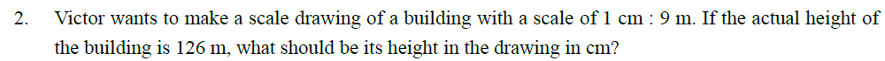











Let x cm be the height of the building in the drawing
$$:$$
$$=$$
x cm
126 m
$$:$$
1 cm
9 m
x cm
1 cm
$$=$$
126 m
9 m
1
x
$$=$$
$$×$$
126
9
$$=$$
14
$$∴$$
The height of the building in the drawing is 14 cm

Slide 28
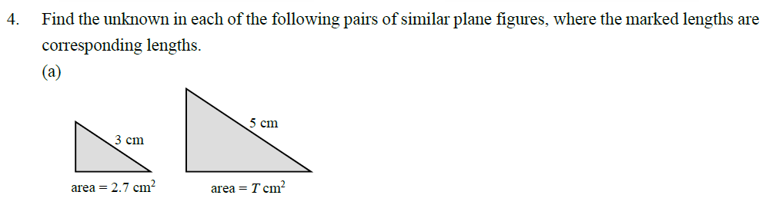








T
2
2
cm
5
$$=$$
2.7
2
3
cm
T
25
$$=$$
2.7
9
25
T
$$=$$
$$×$$
2.7
9
$$=$$
7.5

Slide 29
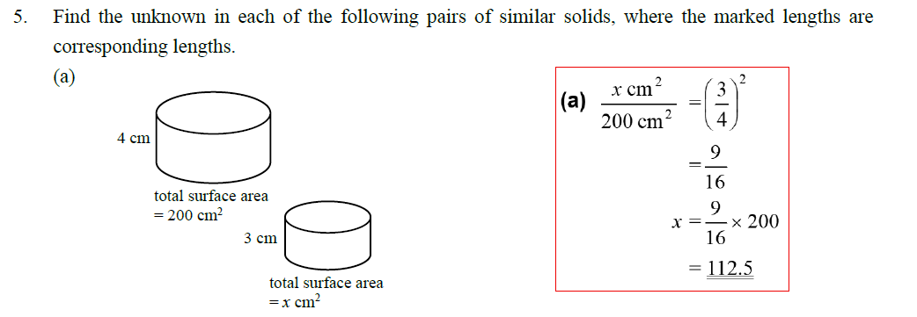








x
2
2
cm
3
$$=$$
200
2
4
cm
9
$$=$$
16
9
x
$$=$$
$$×$$
200
16
$$=$$
112.5

Slide 30
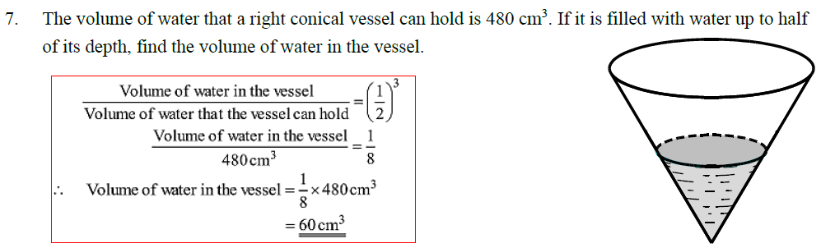










Volume of water in the vessel
1
3
$$=$$
(
)
Volume of water that the vessel can hold
2
Volume of water in the vessel
1
$$=$$
480
3
8
cm
$$∴$$
1
3
Volume of water in the vessel
$$=$$
$$×$$
480
cm
8
$$=$$
60
3
cm

Slide 31
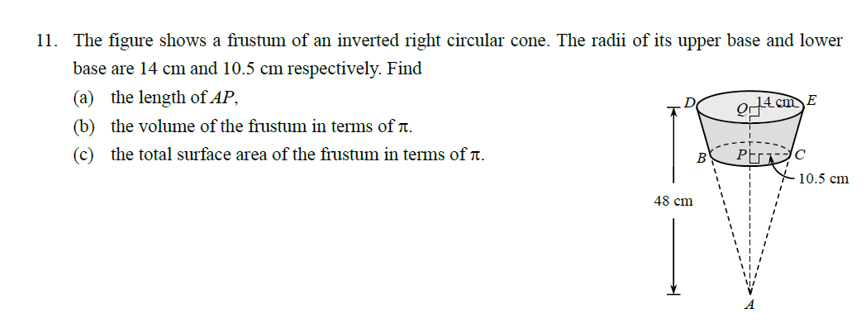
































(a)
$$∵$$
$$ΔAPC \sim ΔAQE \text{(}\text{AAA}\text{)}$$
P
C
$$∴$$
AP
PC
$$=$$
AQ
QE
36 cm
10.5
AP
$$=$$
$$×$$
48 cm
14
$$=$$
36 cm
(b)
Volume of the frustum
A
$$=$$
Volume of the larger circular cone
$$−$$
Volume of the smaller circular cone
1
2
1
2
3
$$=$$
$$×$$
$$π$$
$$×$$
14
$$×$$
$$\text{48}$$
$$−$$
$$×$$
$$π$$
$$×$$
10.5
$$×$$
$$\text{36}$$
cm
3
3
$$=$$
3
3
cm
(3136$π$
1323$π\text{)}$
$$−$$
$$=$$
1813$π$
cm

Slide 32











































(c)
$$\text{EA}$$
$$=$$
$$\text{E}\text{Q}$$
2
$$+$$
$$\text{Q}\text{A}$$
2
$$=$$
2
$$+$$
2
cm
50 cm
$$\text{14}$$
$$\text{48}$$
36 cm
$$=$$
37.5 cm
50 cm
$$\text{CA}$$
$$=$$
$$\text{CP}$$
2
$$+$$
$$\text{PA}$$
2
$$=$$
$$\text{10.5}$$
2
2
cm
$$+$$
$$\text{36}$$
$$=$$
37.5 cm
Total surface area of the frustum
2
2
2
$$π$$
$$π$$
$$π$$
$$×$$
37.5)
cm
$$=$$
$$π$$
$$\text{10.5}$$
$$+$$
(
$$×$$
$$×$$
$$−$$
$$×$$
$$\text{10.5}$$
$$×$$
14
$$+$$
$$×$$
14
50
$$=$$
$$+$$
2
2
$$\text{(}\text{196}π$$
$$+$$
$$\text{110.25}π$$
$$\text{306.25}π\text{)}$$
cm
$$=$$
$$\text{612.5}π$$
cm

Slide 33
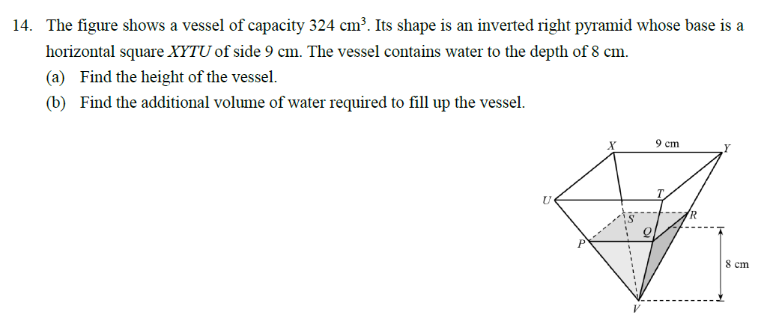










































A
B
(a)
Let h cm be the height of the vessel
1
2
$$×$$
$$\text{9}$$
$$×$$
h
$$=$$
324
D
3
C
h
$$=$$
12
$$∴$$
The height of the vessel is 12 cm
12 cm
(b)
Refer to the notations in the figure
6 cm
1
1
AB
$$=$$
$$×$$
XY
$$=$$
$$×$$
9 cm
$$=$$
4.5 cm
2
2
$$∵$$
$$ΔVCD \sim ΔVAB \text{(}\text{AAA}\text{)}$$
Volume of water in the vessel
A
B
4.5
CD
VC
1
2
3
3
$$∴$$
$$=$$
$$=$$
$$×$$
$$\text{6}$$
$$×$$
$$\text{8}$$
cm
$$=$$
$$\text{96}$$
cm
AB
VA
3
3
$$∴$$
The additional volume of water
C
D
8
12
CD
$$=$$
$$×$$
4.5 cm
$$=$$
3 cm
3
$$=$$
$$−$$
12
$\text{(}$324
$$\text{96}\text{)}$$
cm
8
$$=$$
228
3
PQ
$$=$$
2
$$×$$
CD
$$=$$
2
$$×$$
3 cm
$$=$$
6 cm
cm
V

Slide 34
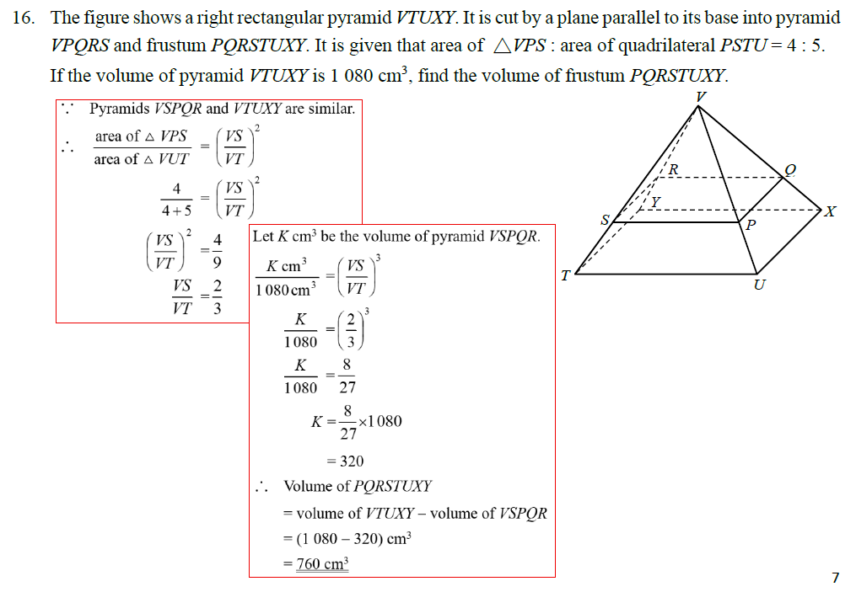




























$$∵$$
Pyramid VSPQR and VTUXY are similar
$$∴$$
area of$ΔVPS$
VS
2
3
$$=$$
Let K cm be the volume of pyramid VSPQR
area of$ΔVUT$
VT
4
VS
2
3
3
$$=$$
K cm
VS
4$+$ 5
$$=$$
VT
3
VT
1080 cm
2
K
2
3
$$∴$$
VS
4
$$=$$
Volume of PQRSTUXY
$$=$$
1080
3
VT
9
K
$$=$$
Volume of VTUXY
Volume of VSPQR
8
$$−$$
$$=$$
VS
2
1080
27
$$=$$
VT
3
$$=$$
$\text{(}$1080
$$\text{320}\text{)}$$
3
K
$$=$$
8
$$−$$
cm
$$×$$
1080
27
$$=$$
760
3
cm
$$=$$
320

Slide 35
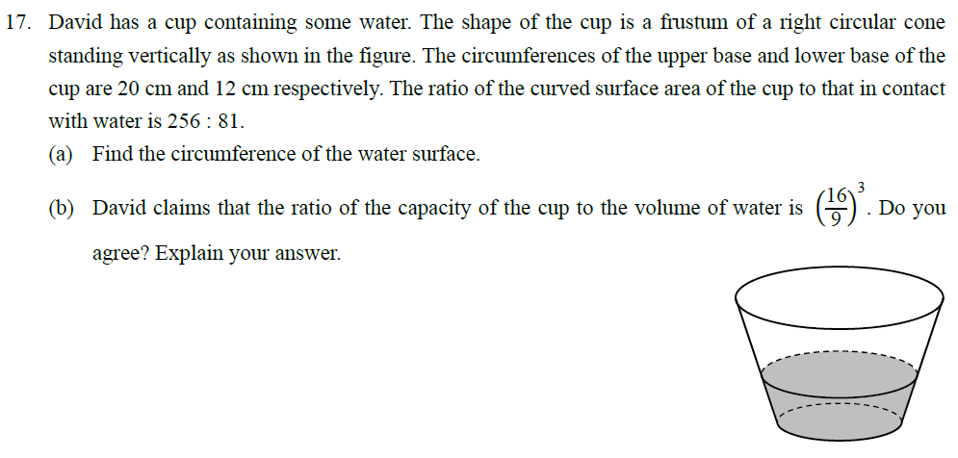

























Let A0, A1 and A2 be the curved surface areas of cones VEF, VCD and VAB respectively
Let x cm be the circumference of the water surface
P
$$∵$$
A
B
Cones VEF, VCD and VAB are similar
A1
x
2
x
2
$$∴$$
$$=$$
$$=$$
Q
A0
12
C
D
144
A2
20
2
25
E
R
$$=$$
$$=$$
F
A0
12
9
According to the question, we have
A2 $−\text{A}\text{0}$
25
2
225
256
$$−$$
1
x
$$=$$
$$=$$
256
A1 $−\text{A}\text{0}$
81
9
$$=$$
x
$$=$$
15
A2
A0
x
2
81
$$−$$
$$−$$
1
$$∴$$
A0
A0
256
144
The circumference of the water surface is 15 cm
$$=$$
2
V
A1
A0
81
9
x
$$−$$
$$=$$
$$−$$
1
A0
A0
16
144

Slide 36















$$=$$
15
cm
3
P
(b)
Let V cm be the volume of cone VEF
A
B
20
3
3
8000V
3
Volume of cone VAB
$$=$$
$$×$$
V cm
$$=$$
cm
Q
12
1728
C
D
15
3
3
3375V
3
R
Volume of cone VCD
$$=$$
$$×$$
V cm
$$=$$
cm
E
F
12
1728
$$∴$$
Capacity of the cup
Volume of water
8000V
3
$$−$$
V
$$∵$$
16
1728
$$=$$
5.618 …
$$≠$$
3.81
$$=$$
$$=$$
3.81
9
3375V
(cor. to 3 sig. fig.)
$$−$$
V
$$∴$$
The claim is disagreed
V
1728

